Slide 1
GCB533 Session 2
Interactive exercise
Binglan Li (Ritchie Lab)
8/21/2020

Slide 2
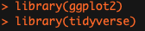
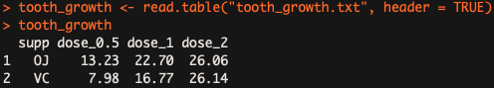
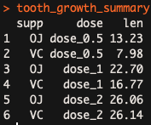
Slide 17-20: Loading and Organize Data in R
Quests
Load libraries – ggplot2 and tidyverse
Load “tooth_growth.txt” to tooth_growth in R
Inspect the data
Organize the tooth_growth into the format that ggplot2 expects
Explanation
The data describes the effect of Vitamin C on tooth growth in Guinea pigs. Three dose levels of Vitamin C (0.5, 1, and 2 mg) with each of two delivery methods [orange juice (OJ) or ascorbic acid (VC)] are used.
Hint
gather()
pivot_longer()
Use ‘?pivot_longer()’ to look up the function documentation in R
Bonus
Alternative data reading packages: readr and data.table
Notes:
tooth_growth <- read.table("tooth_growth.txt", header = TRUE)
tooth_growth
tooth_growth_summary <- gather(tooth_growth, 'dose', 'len', -supp)
tooth_growth_summary <- pivot_longer(tooth_growth, cols = starts_with("dose"), names_to = "dose", values_to = "len")

Slide 3
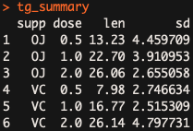
Slide 33-35: Create Your Own Plot
Quests
Load “tooth_growth_summary.txt” to tg_summary in R
Create a connected scatter plot similar to the plot in the lecture slide
(Please do) save the figure object to a variable named “g”
Draw a bar plot using the new tg_summary data
Try out different parameters to understand the functions
Hint
Run this code before visualization
tg_summary$dose <- factor(tg_summary$dose, levels = c(0.5, 1, 2))
What would happen if you don’t use this line of code?
g <- ggplot() + aes() + geom_point() + geom_line()
ggplot(data, aes(x, y, fill)) + geom_bar(stat="identity", color="black", position=position_dodge()) + geom_errorbar(aes(ymin=len-sd, ymax=len+sd), width=.2, position=position_dodge(.9))
Bonus
Handling categorical variables: forcats
Notes:
tg_summary <- read.table("tooth_growth_summary.txt", header = TRUE)
tg_summary$dose <- factor(tg_summary$dose)
tg_summary
g <- ggplot(tg_summary) + aes(x = dose, y = len, color = supp) + geom_point() + geom_line(aes(group = supp))
# draw a bar plot with one standar error bar
ggplot(tg_summary, aes(x=dose, y=len, fill=supp)) +
geom_bar(stat="identity", color="black", position=position_dodge()) +
geom_errorbar(aes(ymin=len-sd, ymax=len+sd), width=.2, position=position_dodge(.9))

Slide 4
Slide 44 – Last Warm-up before the Ultimate Challenge
Quest
Customize the ggplot object g that you have created
Hint
g + facet_grid()
g + coord_flip()
g + coord_polar()
g + scale_color_manual(values)
g + scale_y_log10()
g + scale_x_discrete(labels)

Slide 5
Slide 53 – Ugliest ggplot Competition
Quest
Making an as ugly ggplot figure as you can (example attached)
Google “ugliest-ggplot-theme.R GitHub”
Try out these ggplot theme() configurations
plot.background, plot.title, plot.subtitle, plot.caption
panel.background, panel.border, panel.grid.major.x, panel.grid.minor.x, panel.grid.minor.y
axis.title.x, axis.title.y, axis.text, axis.text.x.bottom
strip.background, strip.text.y, strip.placement
legend.background, legend.key, legend.direction, legend.position, legend.justification, legend.title, legend.text
Don’t forget other geom_* and scale_*_*
https://gist.github.com/emilyriederer/2bf4f67d7e198f8359b61706c82e42ee

